Slide 1
Learning activity 4 / Actividad de aprendizaje 4
Evidence: Describing outfits and likes / Evidencia: Describiendo atuendos y gustos
In this evidence, you will be evaluated on vocabulary on clothes and expressing likes and dislikes regarding clothes. / Por medio de esta evidencia se evaluarán los nombres de las prendas de vestir y los gustos en cuanto a vestimenta.
Find four photographs showing people (they could be unreal) and describe what they are wearing. You also have to describe their preferences and likes by using the structure: She likes or He likes. / Ubique cuatro fotografías de personas (pueden ser ficticias) y describa sus atuendos. Igualmente describa los gustos y preferencias usando la estructura: She likes o He likes.

Slide 2
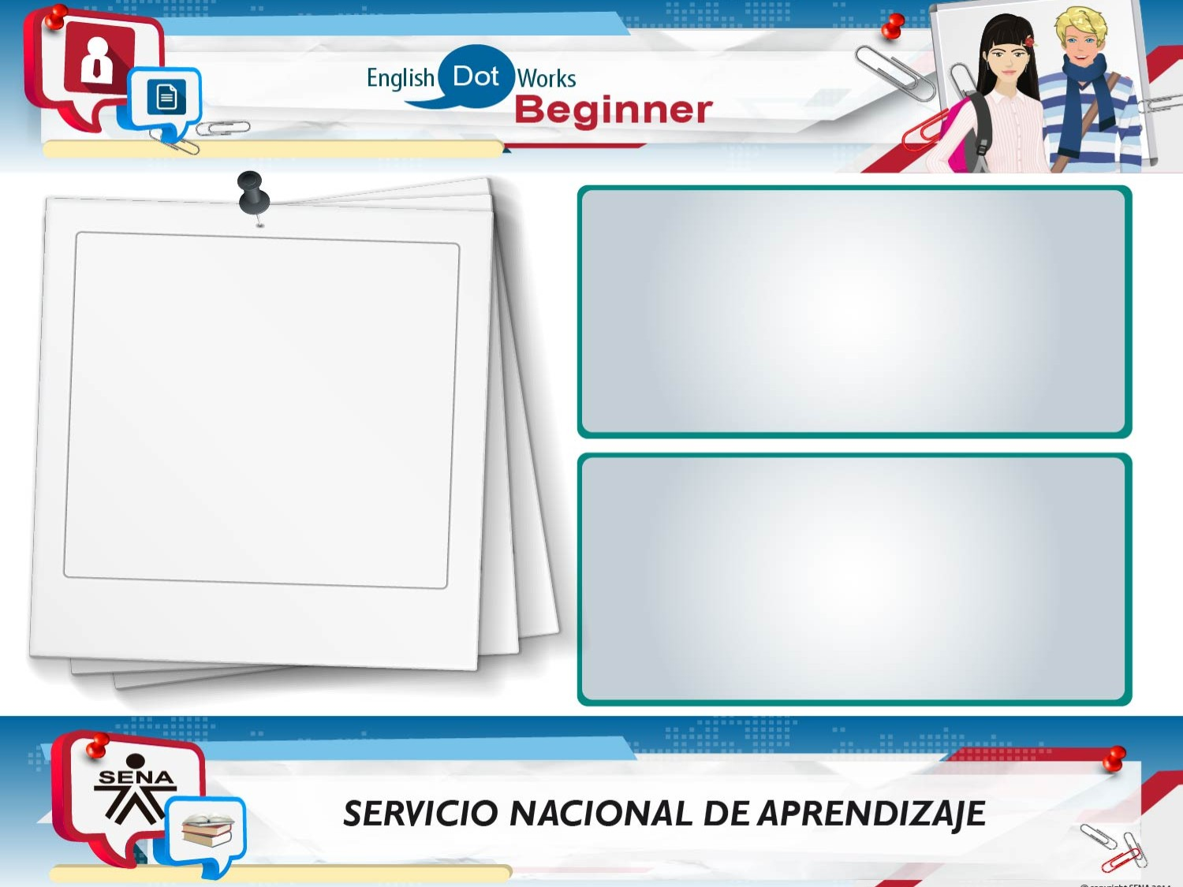
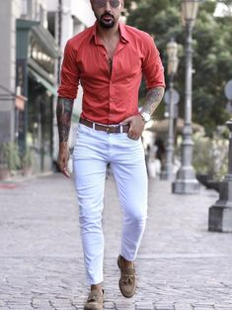
Clothes
He is wearing a red t-shirt, white pants, brown belt and brown shoes.
Likes
He likes the formal clothes, he likes glasses and clock, he is tall and muscular, he doesnt like cloths black.

Slide 3
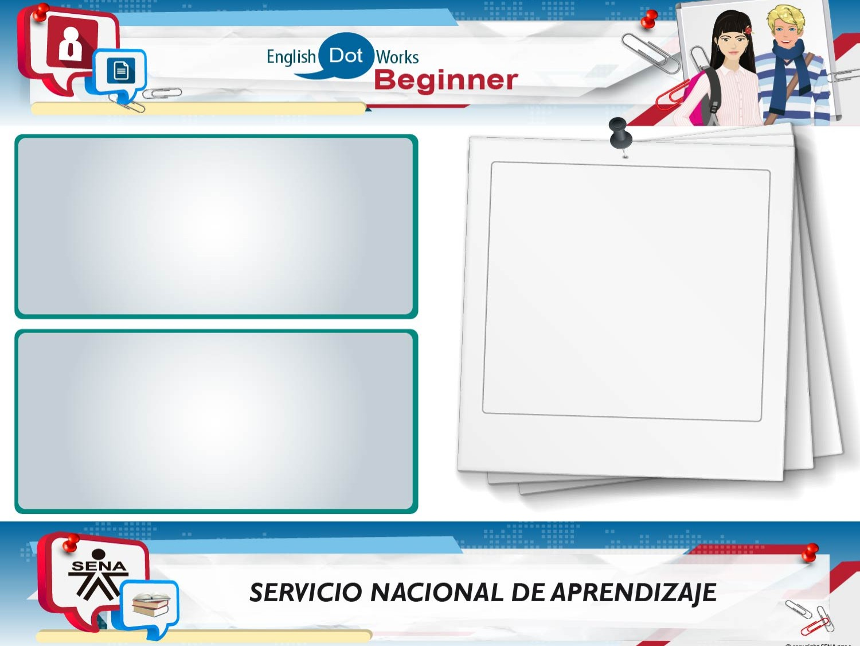
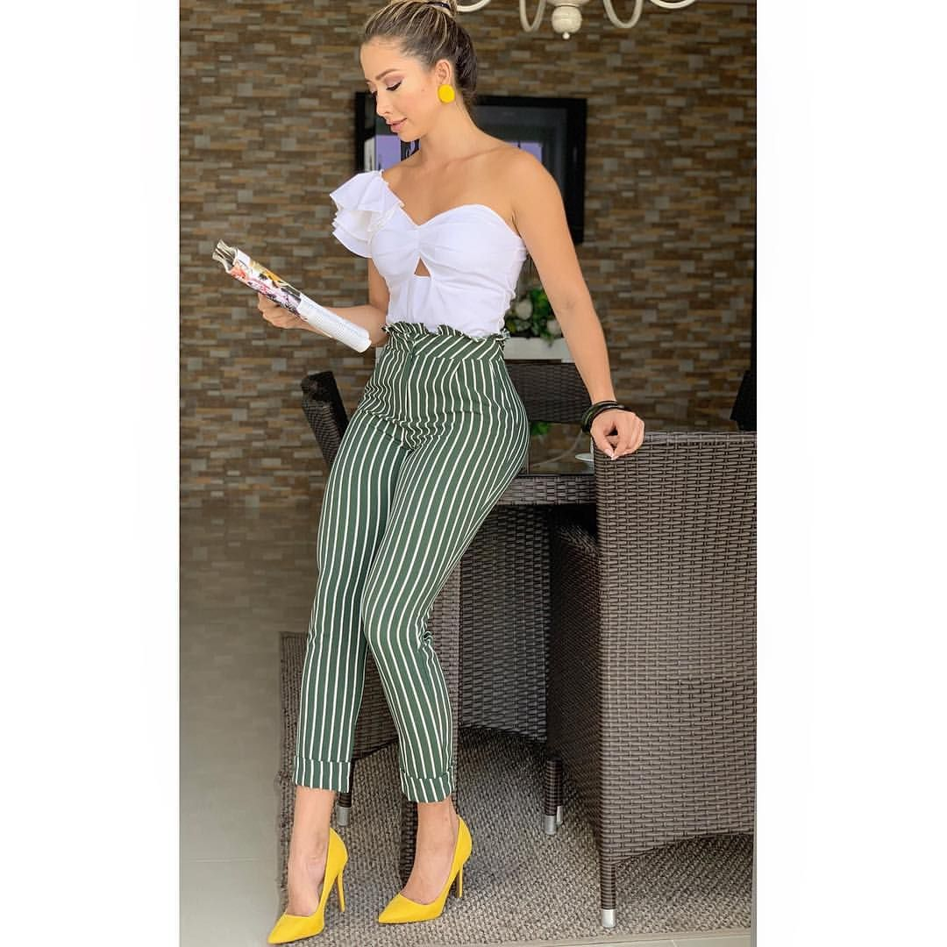
Photo
Clothes
She is wearing a White t-shirt, green pants with líneas White, and yellow high heles.
Likes
She likes the White bluse, she likes handbag, she likes hair blond and she likes to do exercise, she doesnt like caps

Slide 4
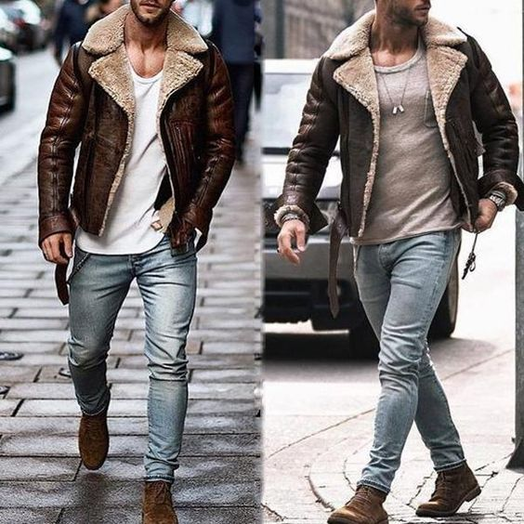
Photo
Clothes
He is wearing a Brown jacket, gray t-shirt, blue jeans and Brown shoes.
Likes
He doesnt like formal clothes, he likes caps, jacket and boots, he like Athletic clothes and he likes the colors clothes gray, borwn and White.

Slide 5
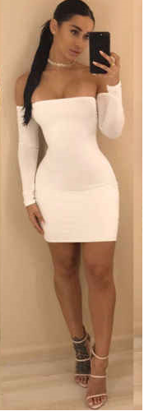
Photo
Clothes
She is wearing a White drees and beige high heles.
Likes
She likes clothes the colors, White, black and red, she likes skirt, she likes blouse, and she likes to ride a bike, and she like to do exercise, she is tal and thin.

Slide 6
When you finish your work, send the file to your instructor through the platform as follows:
Click on the title of this evidence.
Click Examinar mi equipo and look for the file in your computer. Make sure the files is attached.
Leave a comment for the instructor (optional).
Click Enviar.
Note: This evidence is an individual activity. Remember to check the learning guide in order to know if you have done all the assigned activities, know how to develop them and deliver them correctly.

Slide 7
Una vez finalice la evidencia envíe al instructor el archivo a través de la plataforma, así:
Dé clic en el título de esta evidencia.
Dé clic en el enlace Examinar mi equipo y busque el archivo en su
computador. Asegúrese de adjuntar los archivos.
Escriba algún comentario si lo considera pertinente.
Dé clic en Enviar.
Nota: Esta evidencia es de carácter individual. Recuerde revisar la guía de aprendizaje con el fin de verificar que ha realizado todas las actividades propuestas, saber cómo desarrollarlas y entregarlas correctamente.

Slide 8
Criterios de evaluación
Describe prendas de vestir usando la estructura gramatical y el vocabulario solicitado.

